Slide 1
Occupancy Modelling
CSP4141
Thursday, May 24th, 2018
Final Group Exercise
National Conservation Training Center Course
May 21st - 25th, 2018
Columbia River Fisheries Program Office

Slide 2
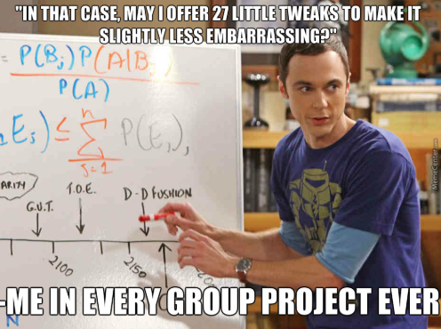
Final Group Project
Work in your assigned groups to complete the final project.
Two day project –
1st day will be the project analysis, etc.,
2nd day will be a group presentations to the class.

Slide 3
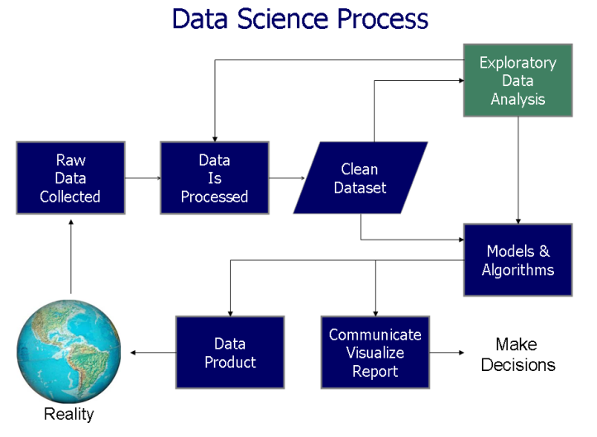
Final Group Project
Thursday, May 24th
Each group will be given a unique scenario that describes a situation for which you must work through an analysis
You’ll need to:
Determine what the research question is;
Determine what type of model to use (SS or MS);
Decide what covariates to use in your model
Data science process flowchart from "Doing Data Science", Cathy O'Neil and Rachel Schutt, 2013

Slide 4

Final Group Project
Thursday, May 24th
After those initial steps, you’ll go through the unmarked workflow described in class:
Work the data- Import data, format data, create unmarkedFrame
Fit models
Analyze results- model fit, prediction, maps, etc.

Slide 5

Final Group Project
Friday, May 25th
Present the scenario, model selection and analysis, and results to the class.
Provide rationale for why you made each decision (model used, covariates used, models fit, model selection, etc.).
Finally, you should provide a final recommendation or interpretation of your results as they relate to the original question presented in the scenario.

Slide 6
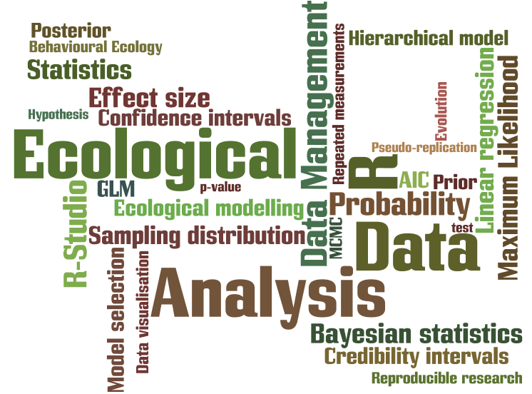
Final Group Project
As you read your scenario and start working, Michelle and Colin will be available for you as a resource if you have questions or get stuck.
ANY QUESTIONS?
http://naturali.i-learn.unito.it/course/index.php?categoryid=64

